Slide 1

Approximate Nearest Neighbors Algorithms
David Diebold
Martin Bompaire
Notes:
Purpose of this presentation is not to give you an exhaustive presentation of knn algorithms.
We will try to focus on HnswLib.

Slide 2
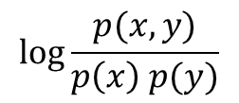
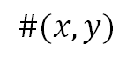
Where did we stop ?
User timelines
PMI
Product pair counts
p₁
p₂
p₅
…
$$\#(x,y)$$
p₁
p₉
p₆
…
$$\log{\frac{p(x, y)}{p\left(x\right) p(y)}}$$
p₇
p₁
p₂
…
Recommended products
Neural network
optimized on clicks
product embeddings
p₁
p₂
p₅
…
Embedding space
product embedding
user embedding
User history
Randomized SVD

Slide 3
Outline
Motivation
Overview of KNN algorithms
Hnsw deep dive
Quantization

Slide 4
Problem Statement (1/2)
Mary
T-Shirt
Model
Relevance

Slide 5
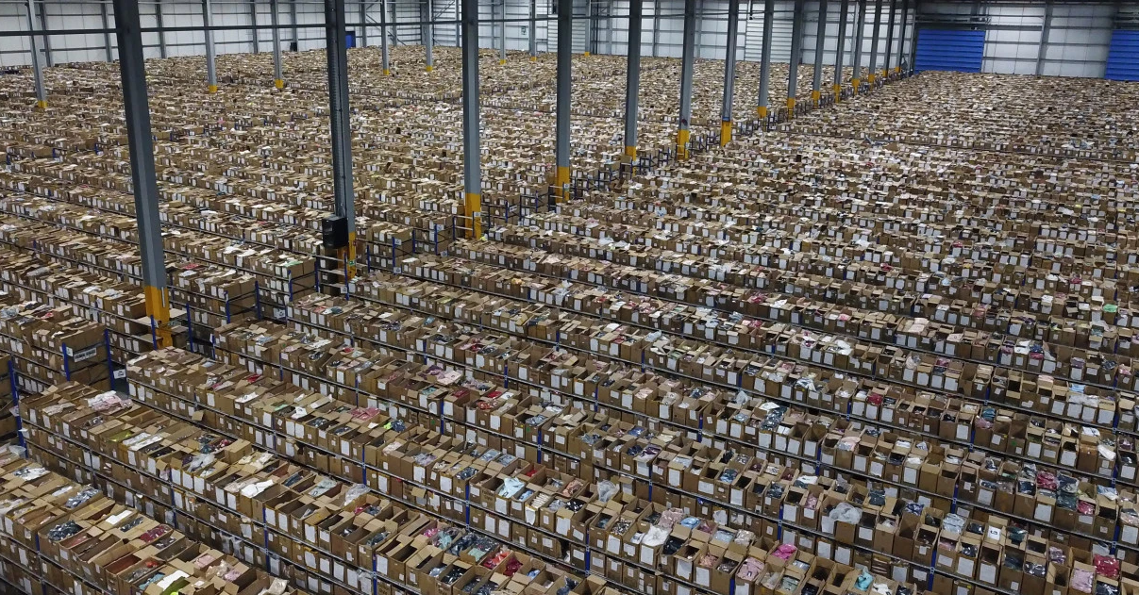
Problem Statement (2/2)

Slide 6

Naive solution : pooling
…
Need to work on a shortlist of candidates, picked carefuly : Pooling
Similarities
Not very great
We may miss interesting items
We may evaluate some items for nothing
When adding a new source sorting against a given score, we need to pass this new kind of score to the oracle (new dimension)
Complementarities
Best of per categories
…
Random

Slide 7
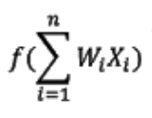
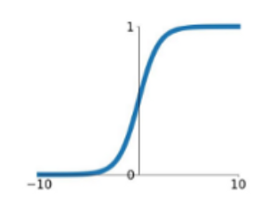
Other solution – Representation learning
Mary as a Vector
T-Shirt as a Vector
Relevance
Notes:
What about cross features ?
=> Not necessarily lost

Slide 8

Finding best item becomes a nearest neighbor problem
$$f(x,y)=\frac{1}{1+ⅇ^{−x.y}}$$
Logistic Regression :
We want to maximize vectors dot product
If each vector is normalized we have :
We want to minimize a distance.
$$ⅆ\left(x,y\right)=\left\|x\right\|+\left\|y\right\|−2x.y$$

Slide 9
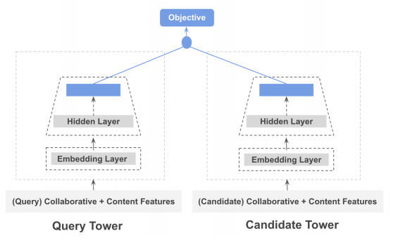
Logistic Regression can be replaced too !

Slide 10
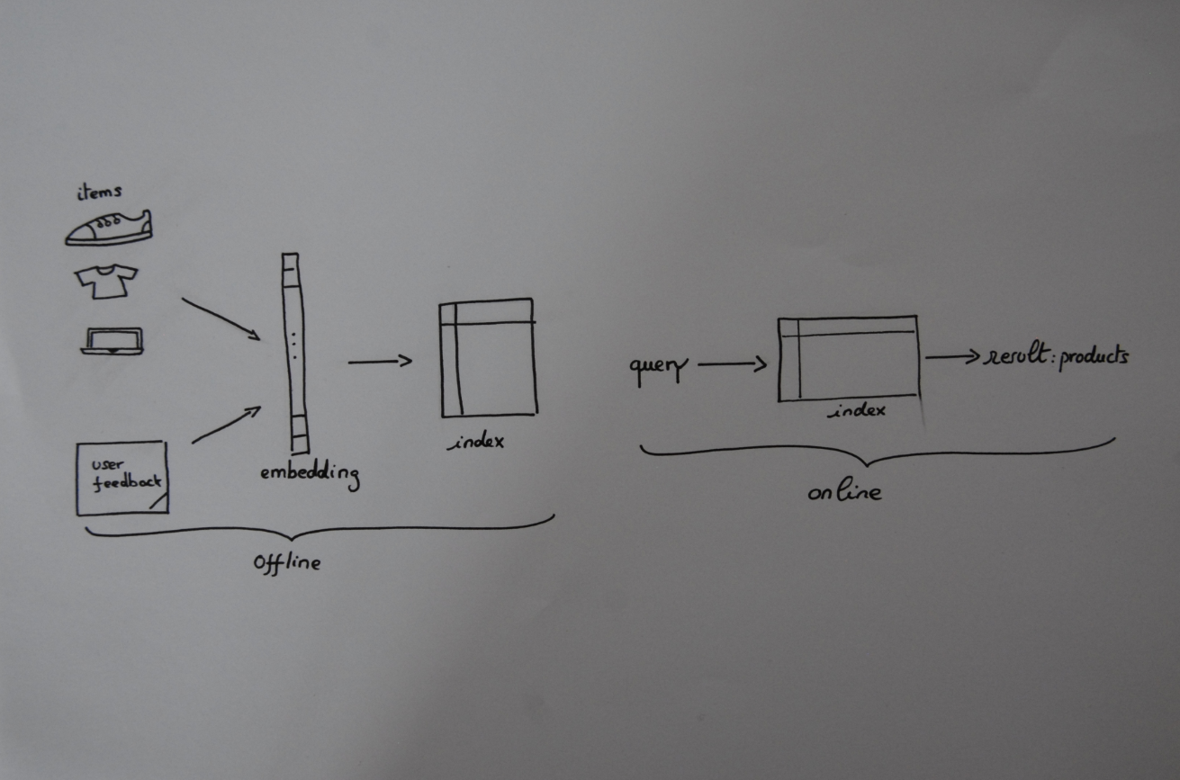
Recommendation System Pipeline

Slide 11
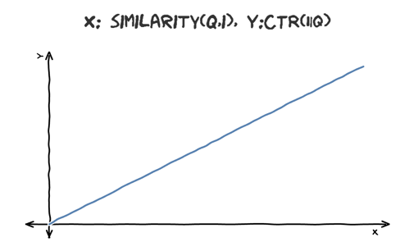
Cold start problem – new user, with particular set of item affinities
We can learn user representation model, such that <user|item> is proportionnal to user-item relevance.

Slide 12
Brute-force complexity is linear ☹
Compare the key item with all existing ones
We want something better !

Slide 13
Overview of KNN methods
Tree based
Hash based
Graph based

Slide 14
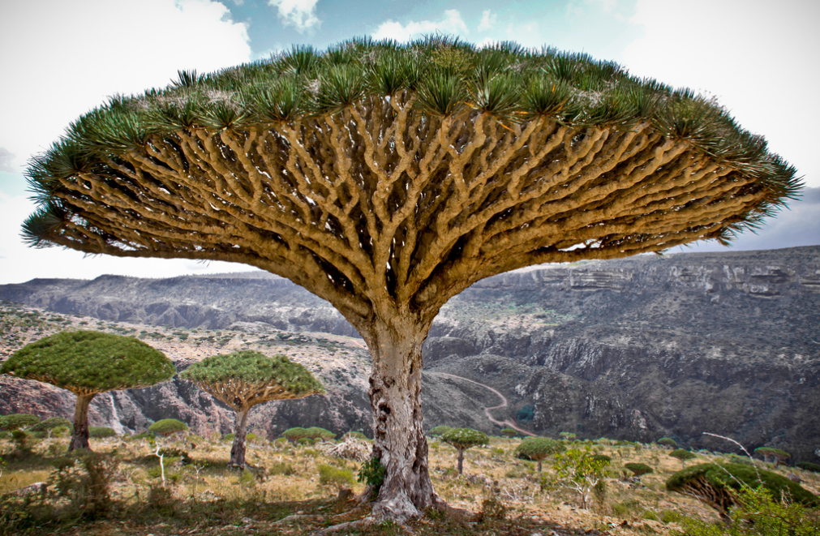
Hierarchical Trees
Notes:
Dragons Blood Tree, Socotra

Slide 15
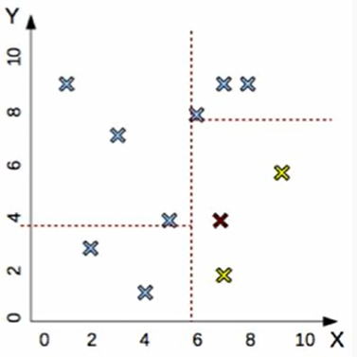
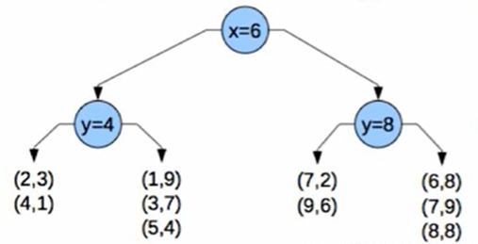
KD Tree
Construction
While cell contains ‘too many’ items:
Pick random axis
Find median
Split cell
Search
Naïve way: Walk the tree, then look for the nearest neighbor inside the leaf.
No guarantee to find THE nearest neighbor.

Slide 16
KD Tree – Exact search
Cell A
Cell E
Cell F
Ideas
It is fast to compute min distance between cell and queried point.
Don’t explore a cell when we know it’s min distance is larger than nearest point found so far.
We use branch-and-bound to find nearest neighbors.
Start with nearest cells first to increase chances to minimize nearest point distance early.
Can be made approximate with some guarantees. Multiply d(query,cell) by (1+Epsilon)
query
Cell B
Cell C
Cell D
Still, not efficient with high dimension vector

Slide 17
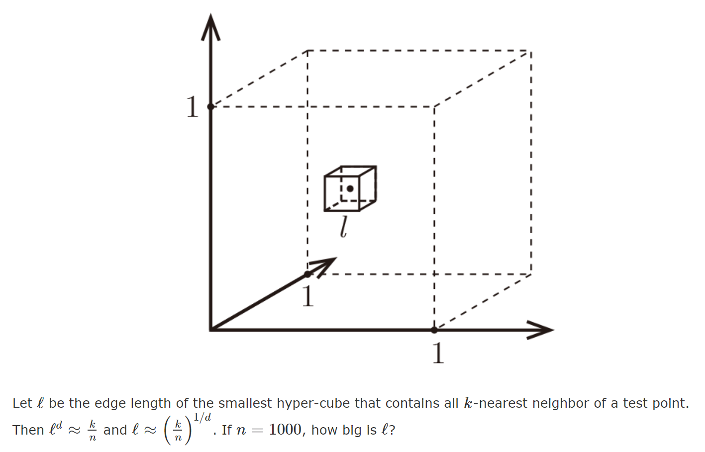
Curse of dimensionality
N points placed uniformly inside the space.

Slide 18
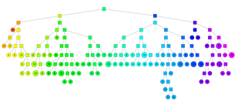
Annoy
Construction
While cell contains ‘too many’ items:
Pick two random points in cell
Split along plane equidistant to the points
Create a Forest !
Search
Branch and bound with additional tricks.
Search on all trees at the same time using same priority queue.
Approximate: don’t explore the other side if it’s too far. Threshold can be changed during the search.
Great performances !

Slide 19

Hash based

Slide 20
Locality-sensitive hashing
Here we want to maximize collisions.
1. Pr(h(a) == h(b)) is high if a and b are near
2. Pr(h(a) == h(b)) is low if a and b are far
3. Time complexity to identify close objects is sub-linear.

Slide 21
Locality-sensitive hashing
Example : bit sampling
Hashing functions : h_i : x ➔ x[i] for i in [0,n-1]
P(h(a)==h(b)) = 1 – d/n
Then we can combine hashing functions to achieve better accuracy.

Slide 22
Locality-sensitive hashing
Other technique : random projection

Slide 23

Graph

Slide 24
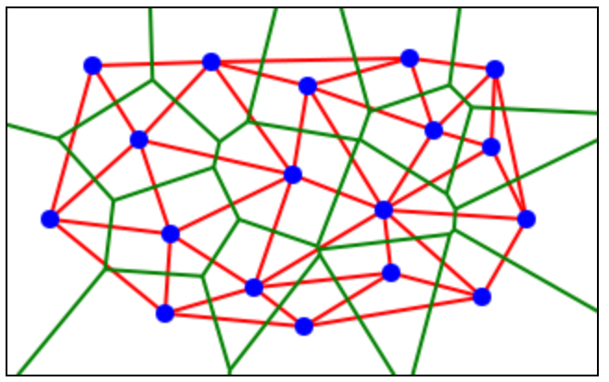
Delaunay Graph (<1975)
item
Voronoï diagram
Delaunay graph
All points within a Voronoï tile have contained blue point as their nearest neighbor.
Don’t expect to have Log(N) by navigating the graph naïvely ! Needs post processing
Does not wok in high dimension space ! (too many connections, too slow)
Notes:
(one can always try to compress the space before using this method : https://arxiv.org/pdf/1802.02422.pdf)

Slide 25
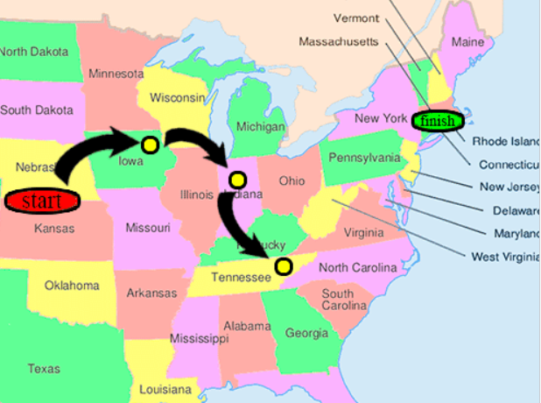
NSW (Navigable Small World)
« All people are six or fewer social connections from each other »
First manuscript written in ~1950 in Paris Sorbonne and circulated a lots. Milgram took up experiments 20 years later : take two random persons and see if/how the origin can manage to contact the destination.
Small world property exists in the nature !
Notes:
https://publications.hse.ru/mirror/pubs/share/folder/x5p6h7thif/direct/128296059

Slide 26
NSW (Navigable Small World)
How do we create small world network ?
In social networks : Dual Phase Evolution
Local phase : people spend most of their time with people they know
Global phase : party/event/hollidays, where people interact with people they don’t know
Links are created during global phases, refined/destroyed in local phase.
Notes:
https://publications.hse.ru/mirror/pubs/share/folder/x5p6h7thif/direct/128296059

Slide 27
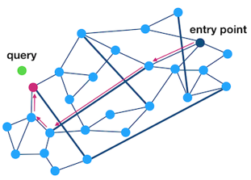
Small world network : is it enough ?
Notes:
https://publications.hse.ru/mirror/pubs/share/folder/x5p6h7thif/direct/128296059

Slide 28
NSW (Navigable Small World)
Navigable property guarantees that greedy algorithm is likely to stay on the sortest path.
Construction : try to enforce every node is connected to its M nearest neighbors.
Search : BFS (piorize neighbors nearest to the query), with stop condition : Worst neighbor found is better than best candidate to visit.
Works not too bad but performance degradations in low dimension / clustered graph.
Notes:
https://publications.hse.ru/mirror/pubs/share/folder/x5p6h7thif/direct/128296059

Slide 29
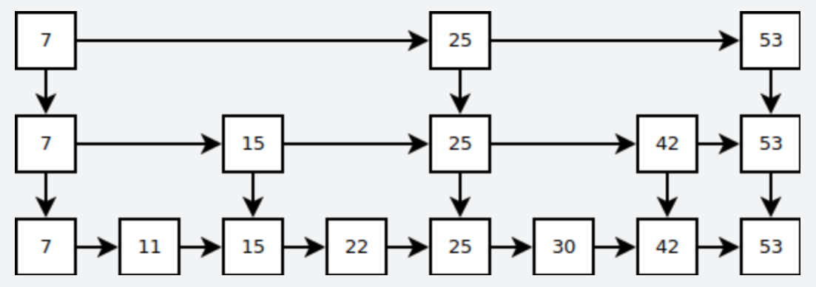
HNSW (Hierarchical NSW)
Idea
https://arxiv.org/ftp/arxiv/papers/1603/1603.09320.pdf
Add ‘highways’ to NSW
Same idea than skip-list and post-processing on Delaunay Graph !

Slide 30
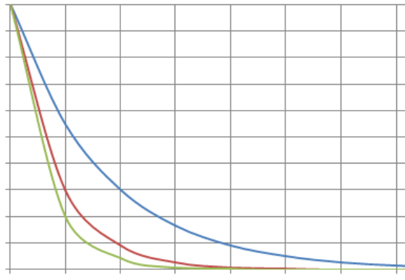
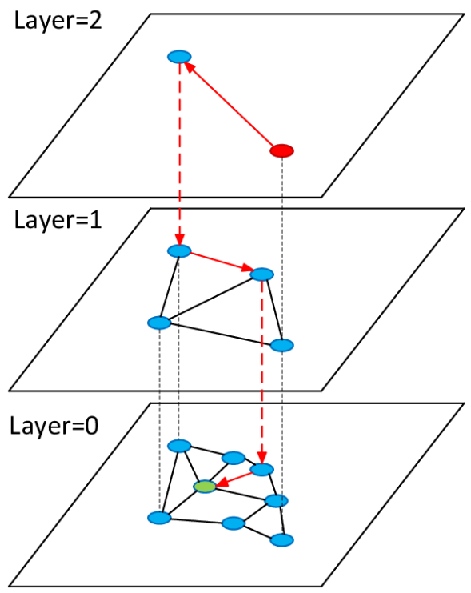
HNSW - Construction
probability
InsertNode(node, start)
Pick it’s level L randomly (exponential decay law)
current ⬅ start
# search in upper layers
for layer in MaxL..L+1:
current ⬅ KNNSearch(node, current, 1, layer)
# fill lower layers
for layer in L..0:
neighbors ⬅ KNNSearch(node, current, M2, layer)
toConnect ⬅ select(node, neighbors, M)
for n in toConnect:
connect node and n
shrink connections of n
current ⬅ neighbors
KNNSearch(query, start, k, layer)
//returns k closest neighbor to query
BFS from starting point, explore points nearest to query first.
Stop condition
Worst neighbor found is better than best candidate to visit.
layer
https://arxiv.org/ftp/arxiv/papers/1603/1603.09320.pdf
Notes:
https://arxiv.org/ftp/arxiv/papers/1603/1603.09320.pdf

Slide 31

HNSW – Toy Example

Slide 32
Current Layer : 0
Inserted Point Layer : 0
ef_construction : 3
Mmax : 3
Legend
Point inside layer
Point being inserted
Search waypoint
Connection in layer
Point outside layer
Point being queried
Root
Search path

Slide 33
Current Layer : 0
Inserted Point Layer : 0
Legend
Point inside layer
Point being inserted
Search waypoint
Connection in layer
Point outside layer
Point being queried
Root
Search path

Slide 34
Current Layer : 0
Inserted Point Layer : 0
c
Legend
Point inside layer
Point being inserted
Search waypoint
Connection in layer
Point outside layer
Point being queried
Root
Search path

Slide 35
Current Layer : 0
Inserted Point Layer : 0
Legend
Point inside layer
Point being inserted
Search waypoint
Connection in layer
Point outside layer
Point being queried
Root
Search path

Slide 36
Current Layer : 0
Inserted Point Layer : 0
Legend
Point inside layer
Point being inserted
Search waypoint
Connection in layer
Point outside layer
Point being queried
Root
Search path

Slide 37
Current Layer : 0
Inserted Point Layer : 0
c
Legend
Point inside layer
Point being inserted
Search waypoint
Connection in layer
Point outside layer
Point being queried
Root
Search path

Slide 38
Current Layer : 0
Inserted Point Layer : 0
c
c
Legend
Point inside layer
Point being inserted
Search waypoint
Connection in layer
Point outside layer
Point being queried
Root
Search path

Slide 39
Current Layer : 0
Inserted Point Layer : 0
Legend
Point inside layer
Point being inserted
Search waypoint
Connection in layer
Point outside layer
Point being queried
Root
Search path

Slide 40
Current Layer : 0
Inserted Point Layer : 0
Legend
Point inside layer
Point being inserted
Search waypoint
Connection in layer
Point outside layer
Point being queried
Root
Search path

Slide 41
Current Layer : 0
Inserted Point Layer : 0
c
Legend
Point inside layer
Point being inserted
Search waypoint
Connection in layer
Point outside layer
Point being queried
Root
Search path

Slide 42
Current Layer : 0
Inserted Point Layer : 0
c
c
Legend
Point inside layer
Point being inserted
Search waypoint
Connection in layer
Point outside layer
Point being queried
Root
Search path

Slide 43
Current Layer : 0
Inserted Point Layer : 0
c
c
c
Legend
Point inside layer
Point being inserted
Search waypoint
Connection in layer
Point outside layer
Point being queried
Root
Search path

Slide 44
Current Layer : 0
Inserted Point Layer : 0
Legend
Point inside layer
Point being inserted
Search waypoint
Connection in layer
Point outside layer
Point being queried
Root
Search path

Slide 45
Current Layer : 0
Inserted Point Layer : 0
Legend
Point inside layer
Point being inserted
Search waypoint
Connection in layer
Point outside layer
Point being queried
Root
Search path

Slide 46
Current Layer : 0
Inserted Point Layer : 0
c
Legend
Point inside layer
Point being inserted
Search waypoint
Connection in layer
Point outside layer
Point being queried
Root
Search path

Slide 47
Current Layer : 0
Inserted Point Layer : 0
c
c
Legend
Point inside layer
Point being inserted
Search waypoint
Connection in layer
Point outside layer
Point being queried
Root
Search path

Slide 48
Current Layer : 0
Inserted Point Layer : 0
c
c
c
Legend
Point inside layer
Point being inserted
Search waypoint
Connection in layer
Point outside layer
Point being queried
Root
Search path

Slide 49
Current Layer : 0
Inserted Point Layer : 0
Legend
Point inside layer
Point being inserted
Search waypoint
Connection in layer
Point outside layer
Point being queried
Root
Search path

Slide 50
Current Layer : 0
Inserted Point Layer : 0
Legend
Point inside layer
Point being inserted
Search waypoint
Connection in layer
Point outside layer
Point being queried
Root
Search path

Slide 51
Current Layer : 0
Inserted Point Layer : 0
Legend
Point inside layer
Point being inserted
Search waypoint
Connection in layer
Point outside layer
Point being queried
Root
Search path

Slide 52
Current Layer : 0
Inserted Point Layer : 1
Legend
Point inside layer
Point being inserted
Search waypoint
Connection in layer
Point outside layer
Point being queried
Root
Search path

Slide 53
Current Layer : 0
Inserted Point Layer : 1
c
Legend
Point inside layer
Point being inserted
Search waypoint
Connection in layer
Point outside layer
Point being queried
Root
Search path

Slide 54
Current Layer : 0
Inserted Point Layer : 1
c
c
Legend
Point inside layer
Point being inserted
Search waypoint
Connection in layer
Point outside layer
Point being queried
Root
Search path

Slide 55
Current Layer : 0
Inserted Point Layer : 1
c
c
c
Legend
Point inside layer
Point being inserted
Search waypoint
Connection in layer
Point outside layer
Point being queried
Root
Search path

Slide 56
Current Layer : 0
Inserted Point Layer : 1
c
c
c
Legend
Point inside layer
Point being inserted
Search waypoint
Connection in layer
Point outside layer
Point being queried
Root
Search path

Slide 57
Current Layer : 0
Inserted Point Layer : 1
Legend
Point inside layer
Point being inserted
Search waypoint
Connection in layer
Point outside layer
Point being queried
Root
Search path

Slide 58
Current Layer : 0
Inserted Point Layer : 1
Legend
Point inside layer
Point being inserted
Search waypoint
Connection in layer
Point outside layer
Point being queried
Root
Search path

Slide 59
Current Layer : 0
Inserted Point Layer : 1
Legend
Point inside layer
Point being inserted
Search waypoint
Connection in layer
Point outside layer
Point being queried
Root
Search path

Slide 60
Current Layer : 1
Inserted Point Layer : 1
Legend
Point inside layer
Point being inserted
Search waypoint
Connection in layer
Point outside layer
Point being queried
Root
Search path

Slide 61
Current Layer : 1
Inserted Point Layer : 0
Legend
Point inside layer
Point being inserted
Search waypoint
Connection in layer
Point outside layer
Point being queried
Root
Search path

Slide 62
Current Layer : 1
Inserted Point Layer : 0
c
Legend
Point inside layer
Point being inserted
Search waypoint
Connection in layer
Point outside layer
Point being queried
Root
Search path

Slide 63
Current Layer : 0
Inserted Point Layer : 0
c
Legend
Point inside layer
Point being inserted
Search waypoint
Connection in layer
Point outside layer
Point being queried
Root
Search path

Slide 64
Current Layer : 0
Inserted Point Layer : 0
c
c
Legend
Point inside layer
Point being inserted
Search waypoint
Connection in layer
Point outside layer
Point being queried
Root
Search path

Slide 65
Current Layer : 0
Inserted Point Layer : 0
c
c
c
Legend
Point inside layer
Point being inserted
Search waypoint
Connection in layer
Point outside layer
Point being queried
Root
Search path

Slide 66
Current Layer : 0
Inserted Point Layer : 0
Legend
Point inside layer
Point being inserted
Search waypoint
Connection in layer
Point outside layer
Point being queried
Root
Search path

Slide 67
Current Layer : 0
Inserted Point Layer : 0
Legend
Point inside layer
Point being inserted
Search waypoint
Connection in layer
Point outside layer
Point being queried
Root
Search path

Slide 68
Current Layer : 0
Inserted Point Layer : 0
Legend
Point inside layer
Point being inserted
Search waypoint
Connection in layer
Point outside layer
Point being queried
Root
Search path

Slide 69
Current Layer : 1
Inserted Point Layer : 0
Legend
Point inside layer
Point being inserted
Search waypoint
Connection in layer
Point outside layer
Point being queried
Root
Search path

Slide 70
Current Layer : 1
Inserted Point Layer : 1
Legend
Point inside layer
Point being inserted
Search waypoint
Connection in layer
Point outside layer
Point being queried
Root
Search path

Slide 71
Current Layer : 1
Inserted Point Layer : 1
c
Legend
Point inside layer
Point being inserted
Search waypoint
Connection in layer
Point outside layer
Point being queried
Root
Search path

Slide 72
Current Layer : 1
Inserted Point Layer : 1
c
Legend
Point inside layer
Point being inserted
Search waypoint
Connection in layer
Point outside layer
Point being queried
Root
Search path

Slide 73
Current Layer : 0
Inserted Point Layer : 0
c
Legend
Point inside layer
Point being inserted
Search waypoint
Connection in layer
Point outside layer
Point being queried
Root
Search path

Slide 74
Current Layer : 0
Inserted Point Layer : 0
c
c
Legend
Point inside layer
Point being inserted
Search waypoint
Connection in layer
Point outside layer
Point being queried
Root
Search path

Slide 75
Current Layer : 0
Inserted Point Layer : 0
c
c
c
Legend
Point inside layer
Point being inserted
Search waypoint
Connection in layer
Point outside layer
Point being queried
Root
Search path

Slide 76
Current Layer : 0
Inserted Point Layer : 0
c
c
c
Legend
Point inside layer
Point being inserted
Search waypoint
Connection in layer
Point outside layer
Point being queried
Root
Search path

Slide 77
Current Layer : 0
Inserted Point Layer : 0
Legend
Point inside layer
Point being inserted
Search waypoint
Connection in layer
Point outside layer
Point being queried
Root
Search path

Slide 78
Current Layer : 0
Inserted Point Layer : 0
Legend
Point inside layer
Point being inserted
Search waypoint
Connection in layer
Point outside layer
Point being queried
Root
Search path

Slide 79
Current Layer : 0
Inserted Point Layer : 0
Legend
Point inside layer
Point being inserted
Search waypoint
Connection in layer
Point outside layer
Point being queried
Root
Search path

Slide 80
Current Layer : 1
Inserted Point Layer : 0
Legend
Point inside layer
Point being inserted
Search waypoint
Connection in layer
Point outside layer
Point being queried
Root
Search path

Slide 81
Current Layer : 1
Inserted Point Layer : 0
c
Legend
Point inside layer
Point being inserted
Search waypoint
Connection in layer
Point outside layer
Point being queried
Root
Search path

Slide 82
Current Layer : 0
Inserted Point Layer : 0
c
Legend
Point inside layer
Point being inserted
Search waypoint
Connection in layer
Point outside layer
Point being queried
Root
Search path

Slide 83
Current Layer : 0
Inserted Point Layer : 0
c
c
Legend
Point inside layer
Point being inserted
Search waypoint
Connection in layer
Point outside layer
Point being queried
Root
Search path

Slide 84
Current Layer : 0
Inserted Point Layer : 0
c
c
c
Legend
Point inside layer
Point being inserted
Search waypoint
Connection in layer
Point outside layer
Point being queried
Root
Search path

Slide 85
Current Layer : 0
Inserted Point Layer : 0
Legend
Point inside layer
Point being inserted
Search waypoint
Connection in layer
Point outside layer
Point being queried
Root
Search path

Slide 86
Current Layer : 0
Inserted Point Layer : 0
Legend
Point inside layer
Point being inserted
Search waypoint
Connection in layer
Point outside layer
Point being queried
Root
Search path

Slide 87
Current Layer : 0
Inserted Point Layer : 0
Legend
Point inside layer
Point being inserted
Search waypoint
Connection in layer
Point outside layer
Point being queried
Root
Search path

Slide 88
Current Layer : 1
Inserted Point Layer : 1
Legend
Point inside layer
Point being inserted
Search waypoint
Connection in layer
Point outside layer
Point being queried
Root
Search path

Slide 89
Current Layer : 1
Inserted Point Layer : 1
c
Legend
Point inside layer
Point being inserted
Search waypoint
Connection in layer
Point outside layer
Point being queried
Root
Search path

Slide 90
Current Layer : 1
Inserted Point Layer : 1
c
c
Legend
Point inside layer
Point being inserted
Search waypoint
Connection in layer
Point outside layer
Point being queried
Root
Search path

Slide 91
Current Layer : 1
Inserted Point Layer : 1
c
c
Legend
Point inside layer
Point being inserted
Search waypoint
Connection in layer
Point outside layer
Point being queried
Root
Search path

Slide 92
Current Layer : 0
Inserted Point Layer : 1
c
c
Legend
Point inside layer
Point being inserted
Search waypoint
Connection in layer
Point outside layer
Point being queried
Root
Search path

Slide 93
Current Layer : 0
Inserted Point Layer : 1
c
c
c
Legend
Point inside layer
Point being inserted
Search waypoint
Connection in layer
Point outside layer
Point being queried
Root
Search path

Slide 94
Current Layer : 0
Inserted Point Layer : 1
c
c
c
Legend
Point inside layer
Point being inserted
Search waypoint
Connection in layer
Point outside layer
Point being queried
Root
Search path

Slide 95
Current Layer : 0
Inserted Point Layer : 1
Legend
Point inside layer
Point being inserted
Search waypoint
Connection in layer
Point outside layer
Point being queried
Root
Search path

Slide 96
Current Layer : 0
Inserted Point Layer : 1
Legend
Point inside layer
Point being inserted
Search waypoint
Connection in layer
Point outside layer
Point being queried
Root
Search path

Slide 97
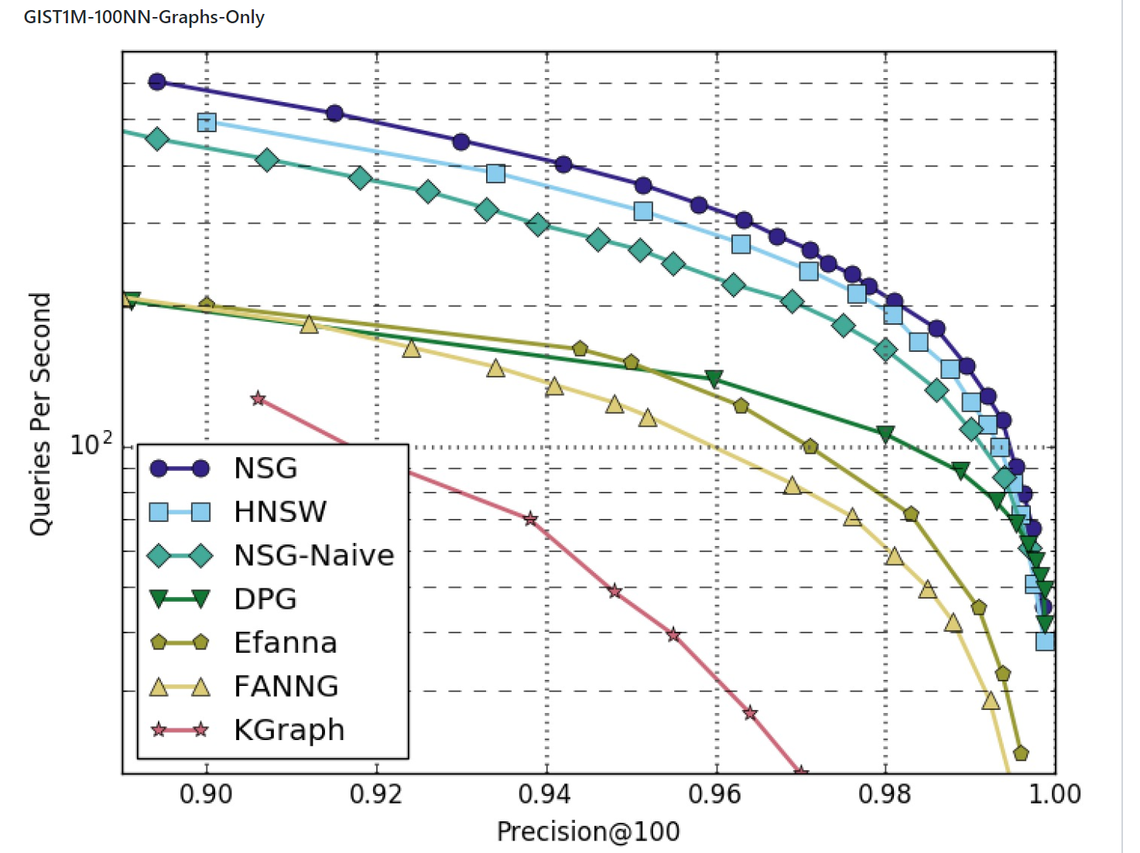
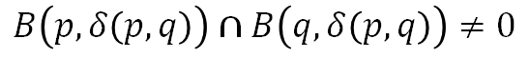
Still state of the art ?
EFANNA NSG (Alibaba)
http://www.vldb.org/pvldb/vol12/p461-fu.pdf
Connect p and q iif :
$$B\left(p, δ\left(p,q\right)\right)∩B\left(q,δ\left(p,q\right)\right)≠0$$
Notes:
Sift dataset (image descriptors)
100 nearest neighbor !

Slide 98
Still state of the art ?
NGT ONNG (yahoo Japan)
Same principle than hnsw with extra heuristics to decide which connections to cut when a node has too many connections.
https://arxiv.org/pdf/1810.07355.pdf
Notes:
https://arxiv.org/pdf/1802.02422.pdf : no comparison with other works

Slide 99
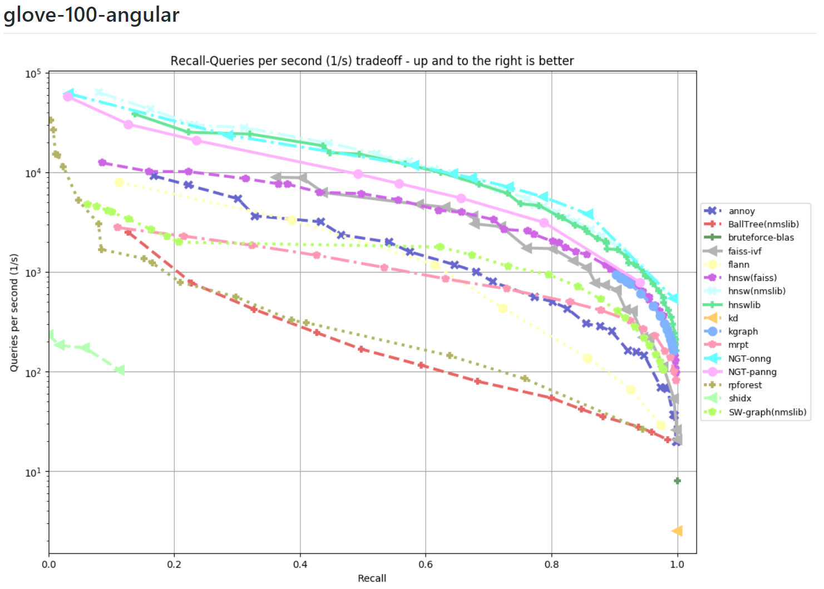
Benchmark Results
HnswLib : hnsw implementation, very simple C library, Cpu based, uses vectorization heavily, python bindings
Faiss : supports hnsw, quantization ; python bindings (also see https://github.com/criteo/autofaiss)
Notes:
Glove : word representations

Slide 100
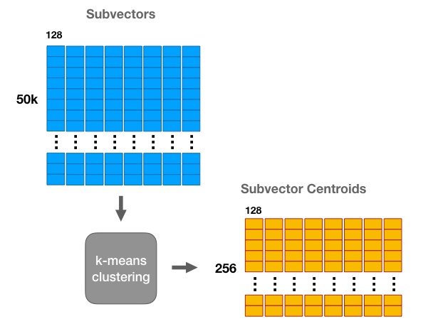
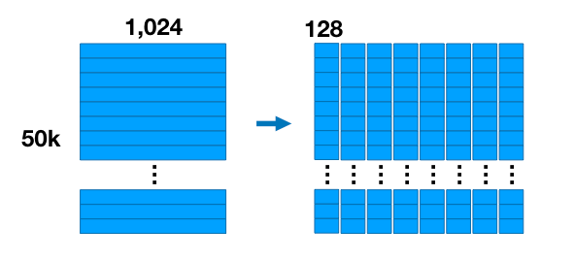
Quantization
New bottleneck : embeddings need to be stored in memory.
1 billion products just can’t be stored the naive way.
First solution : decrease float precision : float16, float8
Second solution : compression with centroids

